Slide 1
CS 4700:
Foundations of Artificial Intelligence
Prof. Carla P. Gomes
gomes@cs.cornell.edu
Module:
Ensemble Learning
(Reading: Chapter 18.4)

Slide 2
Ensemble Learning
So far – learning methods that learn a single hypothesis, chosen form a hypothesis space that is used to make predictions.
Ensemble learning → select a collection (ensemble) of hypotheses and combine their predictions.
Example 1 - generate 100 different decision trees from the same or different training set and have them vote on the best classification for a new example.
Key motivation: reduce the error rate. Hope is that it will become much more unlikely that the ensemble of will misclassify an example.

Slide 3
Learning Ensembles
Learn multiple alternative definitions of a concept using different training data or different learning algorithms.
Combine decisions of multiple definitions, e.g. using weighted voting.
Training Data
⋅ ⋅ ⋅ ⋅ ⋅ ⋅ ⋅ ⋅
Data1
Data2
Data m
Learner1
Learner2
⋅ ⋅ ⋅ ⋅ ⋅ ⋅ ⋅ ⋅
Learner m
⋅ ⋅ ⋅ ⋅ ⋅ ⋅ ⋅ ⋅
Model1
Model2
Model m
Model Combiner
Final Model
Source: Ray Mooney

Slide 4
Value of Ensembles
“No Free Lunch” Theorem
  No single algorithm wins all the time!
When combing multiple independent and diverse decisions each of which is at least more accurate than random guessing, random errors cancel each other out, correct decisions are reinforced.
Examples: Human ensembles are demonstrably better
  How many jelly beans in the jar?: Individual estimates vs. group average.
  Who Wants to be a Millionaire: Audience vote.
Source: Ray Mooney

Slide 5


Example: Weather Forecast
Reality
1
2
3
4
5
Combine
X
X
X
X
X
X
X
X
X
X
X
X
X

Slide 6
Intuitions
Majority vote
Suppose we have 5 completely independent classifiers…
  If accuracy is 70% for each
    (.7⁵)+5(.7⁴)(.3)+ 10 (.7³)(.3²)
    83.7% majority vote accuracy
  101 such classifiers
    99.9% majority vote accuracy
Note: Binomial Distribution: The probability of observing x heads in a sample of n independent coin tosses,
where in each toss the probability of heads is p, is

Slide 7
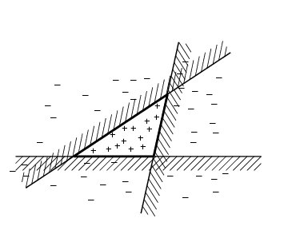
Ensemble Learning
Another way of thinking about ensemble learning:
→ way of enlarging the hypothesis space, i.e., the ensemble itself is a hypothesis and the new hypothesis space is the set of all possible ensembles constructible form hypotheses of the original space.
Increasing power of ensemble learning:
Three linear threshold hypothesis
(positive examples on the non-shaded side);
Ensemble classifies as positive any example classified
positively be all three. The resulting triangular region hypothesis
is not expressible in the original hypothesis space.

Slide 8
Different Learners
Different learning algorithms
Algorithms with different choice for parameters
Data set with different features
Data set = different subsets

Slide 9
Homogenous Ensembles
Use a single, arbitrary learning algorithm but manipulate training data to make it learn multiple models.
  Data1 ≠ Data2 ≠ … ≠ Data m
  Learner1 = Learner2 = … = Learner m
Different methods for changing training data:
  Bagging: Resample training data
  Boosting: Reweight training data
In WEKA, these are called meta-learners, they take a learning algorithm as an argument (base learner) and create a new learning algorithm.

Slide 10
Bagging

Slide 11
Bagging
Create ensembles by “bootstrap aggregation”, i.e., repeatedly randomly resampling the training data (Brieman, 1996).
Bootstrap: draw N items from X with replacement
Bagging
  Train M learners on M bootstrap samples
  Combine outputs by voting (e.g., majority vote)
Decreases error by decreasing the variance in the results due to unstable learners, algorithms (like decision trees and neural networks) whose output can change dramatically when the training data is slightly changed.

Slide 12
Bagging - Aggregate Bootstrapping
Given a standard training set D of size n
For i = 1 .. M
  Draw a sample of size n*<n from D uniformly and with replacement
  Learn classifier C_{i}
Final classifier is a vote of C₁ .. C_{M}
Increases classifier stability/reduces variance

Slide 13
Boosting

Slide 14
Strong and Weak Learners
Strong Learner →Objective of machine learning
  Take labeled data for training
  Produce a classifier which can be arbitrarily accurate
Weak Learner
  Take labeled data for training
  Produce a classifier which is more accurate than random guessing

Slide 15
Boosting
Weak Learner: only needs to generate a hypothesis with a training accuracy greater than 0.5, i.e., < 50% error over any distribution
Learners
  Strong learners are very difficult to construct
  Constructing weaker Learners is relatively easy
Questions: Can a set of weak learners create a single strong learner ?
YES ☺
  Boost weak classifiers to a strong learner

Slide 16
Boosting
Originally developed by computational learning theorists to guarantee performance improvements on fitting training data for a weak learner that only needs to generate a hypothesis with a training accuracy greater than 0.5 (Schapire, 1990).
Revised to be a practical algorithm, AdaBoost, for building ensembles that empirically improves generalization performance (Freund & Shapire, 1996).
Key Insights
Instead of sampling (as in bagging) re-weigh examples!
Examples are given weights. At each iteration, a new hypothesis is learned (weak learner) and the examples are reweighted to focus the system on examples that the most recently learned classifier got wrong.
Final classification based on weighted vote of weak classifiers

Slide 17









Adaptive Boosting
Each rectangle corresponds to an example,
with weight proportional to its height.
Crosses correspond to misclassified examples.
Size of decision tree indicates the weight of that hypothesis in the final ensemble.

Slide 18
Construct Weak Classifiers
Using Different Data Distribution
  Start with uniform weighting
  During each step of learning
    Increase weights of the examples which are not correctly learned by the weak learner
    Decrease weights of the examples which are correctly learned by the weak learner
Idea
  Focus on difficult examples which are not correctly classified in the previous steps

Slide 19
Combine Weak Classifiers
Weighted Voting
  Construct strong classifier by weighted voting of the weak classifiers
Idea
  Better weak classifier gets a larger weight
  Iteratively add weak classifiers
    Increase accuracy of the combined classifier through minimization of a cost function

Slide 20
Adaptive Boosting:
High Level Description
C =0; /* counter*/
M = m; /* number of hypotheses to generate*/
1 Set same weight for all the examples (typically each example has weight = 1);
2 While (C < M)
2.1 Increase counter C by 1.
2.2 Generate hypothesis h_{C} .
2.3 Increase the weight of the misclassified examples in hypothesis h_{C}
3 Weighted majority combination of all M hypotheses (weights according to how well it performed on the training set).
Many variants depending on how to set the weights and how to combine the hypotheses. ADABOOST → quite popular!!!!

Slide 21
Performance of Adaboost
Learner = Hypothesis = Classifier
Weak Learner: < 50% error over any distribution
M number of hypothesis in the ensemble.
If the input learning is a Weak Learner, then ADABOOST will return a
hypothesis that classifies the training data perfectly for a large enough M,
boosting the accuracy of the original learning algorithm on the training
data.
Strong Classifier: thresholded linear combination of weak learner outputs.

Slide 22
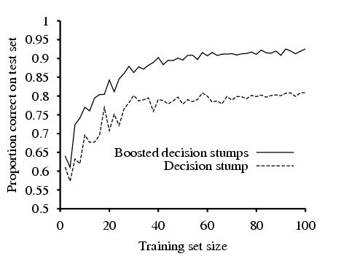
Restaurant Data
Decision stump: decision trees with just one test at the root.

Slide 23
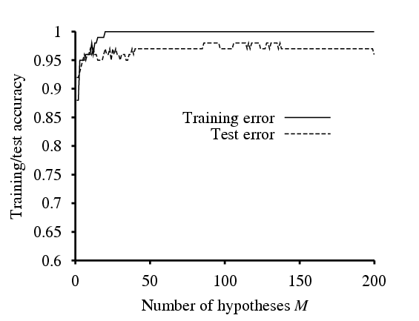
Restaurant Data
Training error reaches zero for M=20 (as predicted by the theorem),
and remains zero as more stumps are added to the ensemble.
Test performance continues to increase after training set
error has reached zero.
Boosting approximates
Bayesian Learning, which can be shown
to be an optimal learning algorithm.

Slide 24
Netflix

Slide 25


Netflix
Users rate movies (1,2,3,4,5 stars);
Netflix makes suggestions to users based on previous rated movies.

Slide 26
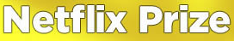

http://www.netflixprize.com/index
Since October 2006
“The Netflix Prize seeks to substantially improve the accuracy of
predictions about how much someone is going to love a movie
based on their movie preferences. Improve it enough and you win one
(or more) Prizes. Winning the Netflix Prize improves our ability to
connect people to the movies they love.”

Slide 27
http://www.netflixprize.com/index
Since October 2006
Supervised learning task
  Training data is a set of users and ratings (1,2,3,4,5 stars) those users have given to movies.
  Construct a classifier that given a user and an unrated movie, correctly classifies that movie as either 1, 2, 3, 4, or 5 stars
$1 million prize for a 10% improvement over
Netflix’s current movie recommender/classifier
(MSE = 0.9514)

Slide 28
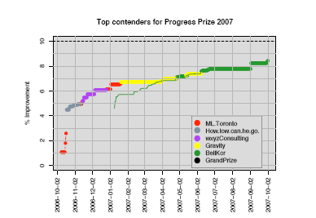
BellKor / KorBell
Scores of the leading team for the first 12 months of the Netflix Prize.
Colors indicate when a given team had the lead. The % improvement is over
Netflix’ Cinematch algorithm.
The million dollar
Grand Prize level is shown as a dotted line at 10% improvement.
BellKor/KorBell
from http://www.research.att.com/~volinsky/netflix/

Slide 29
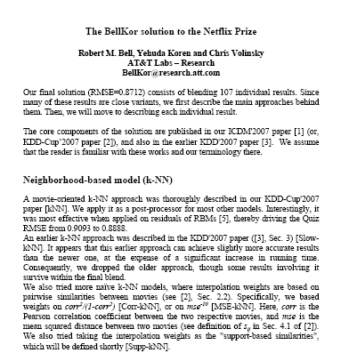
“Our final solution
(RMSE=0.8712)
consists of
blending
107 individual results. “

Slide 30
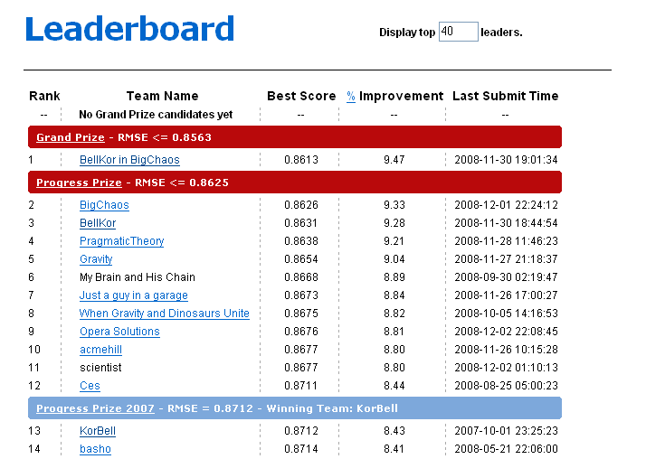
2008-11-30

Slide 31
Your Next Assignment
10% improvement over
Netflix’s current movie recommender/classifier
(MSE = 0.9514)
Win $1 million prize!!!
The End ☺!
Thank You!

Slide 32
EXAM INFO
Topics from Russell and Norvig:
Part I --- AI and Characterization of Agents and environments
(Chapter 1,2)
General Knowledge
Part II --- PROBLEM SOLVING
--- the various search techniques
--- uninformed / informed / game playing
--- constraint satisfaction problems, different forms of consistency (FC,ACC, ALLDIFF)
(Chapter 3, excluding 3.6; chapter 4, excluding Memory-bounded heuristic search, 4.4., and 4.5; chapter 5, excluding Intelligent backtracking, and 5.4; chapter 6, excluding 6.5)

Slide 33
Part III --- KNOWLEDGE AND REASONING
e.g.
--- propositional / first-order logic
--- syntax / semantics
--- capturing a domain (how to use the logic)
--- logic entailment, soundness, and completeness
---SAT encodings (excluding extra slides on SAT clause learning)
---Easy-hard-easy regions/phase transitions
--- inference (forward/backward chaining, resolution / unification / skolemizing)
--- check out examples
(Chapter 7, chapter 8, chapter 9)

Slide 34
Part VI --- LEARNING (chapt. 18, and 20.4 and 20.5)
e.g.
--- decision tree learning
--- decision lists
--- information gain
--- generalization
--- noise and overfitting
--- cross-validation
--- chi-squared testing (not in the final)
--- probably approximately correct (PAC)
--- sample complexity (how many examples?)
--- ensemble learning (not in final)

Slide 35
Part VI --- LEARNING (chapt. 18, and 20.4, 20.5,and 20.6
e.g.
--- k-nearest neighbor
--- neural network learning
--- structure of networks
--- perceptron ("equations")
--- multi-layer networks
--- backpropagation (not details of the derivation)
---SVM (not in the final)

Slide 36
**** USE LECTURE NOTES AS A STUDY GUIDE! ****
**** book covers more than done in the lectures ****
**** but only (and all) material covered in the lectures goes ****
**** all lectures on-line *****
**** WORK THROUGH EXAMPLES!! *****
**** closed book *****
**** 2 pages with notes allowed *****
**** WORK THROUGH EXAMPLES!! *****
Midterm/Homework Assignments
**** Review Session – Saturday and Wednesday****
Sample of problems (a number of review problems will be presented; we’ll also post the solutions after Saturday review session)

Slide 37
The End ☺!
Thank You!

